Slide 1



Distributed Tensorflow with Kubernetes
Jakob Karalus, @krallistic,

Slide 2
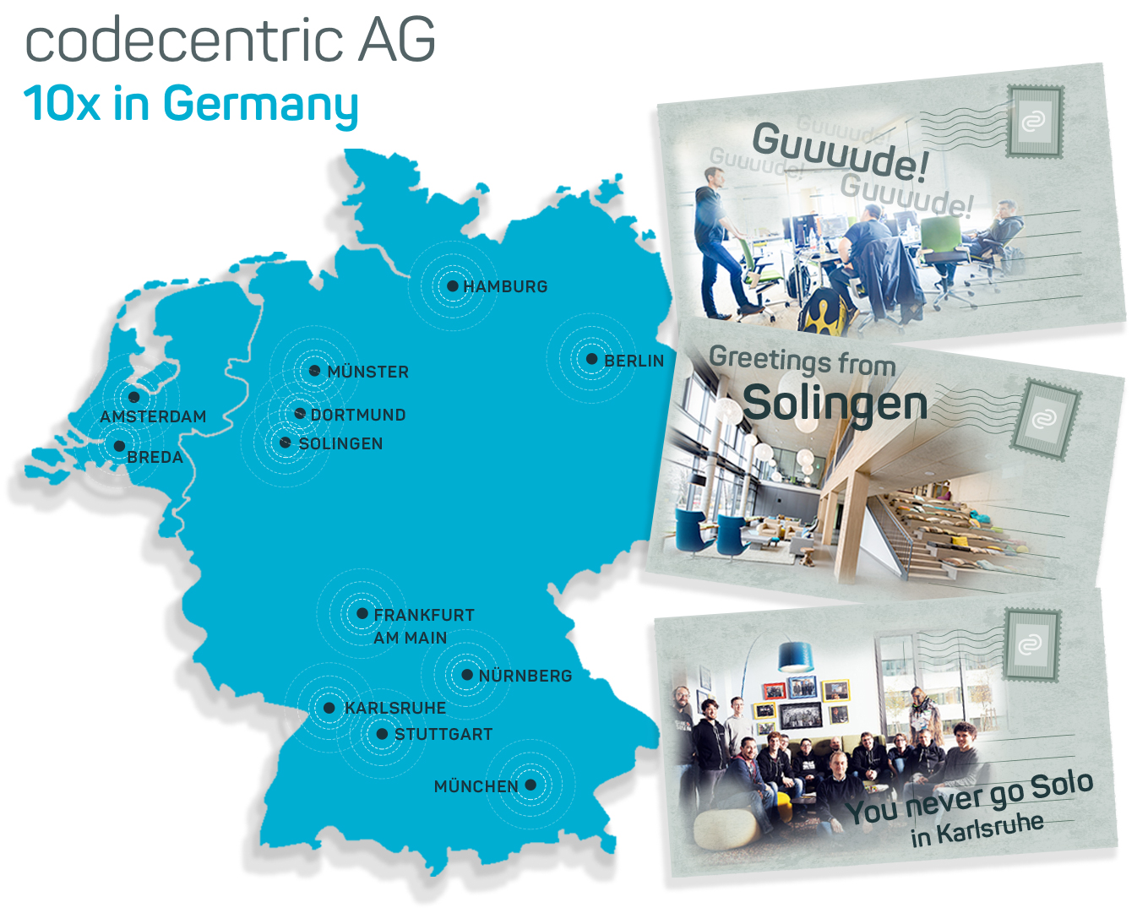
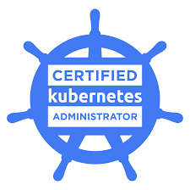
$whoami
Data Science + DevOps
Codecentric
CKA
Twiiter: @krallistic
Github: github.com/krallistic

Slide 3
AGENDA
Distributed Tensorflow & Kubernetes
Motivation
Distributed Tensorflow
Kubernetes
Demo

Slide 4
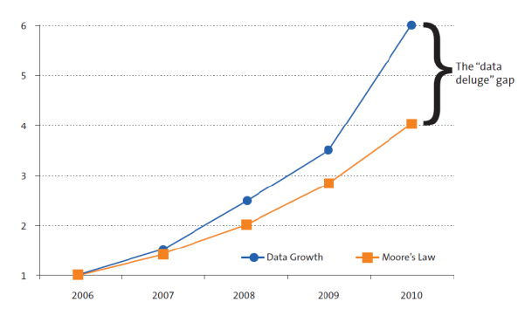
Training nNeural Networks
First steps are quick and easy.
Single node neural networks
We want:
More data!
Deeper models!
Wider model!
Higher mccuracy!
(Single Node) Compute cant keep up
Longer trainingstime -> Longer cycles -> Lower productivity

Slide 5
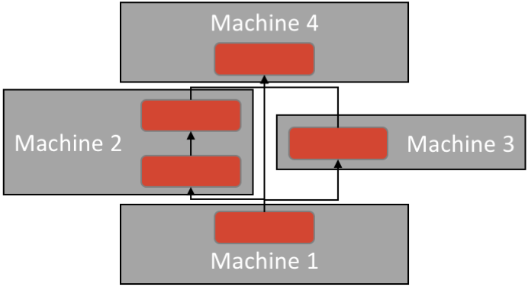
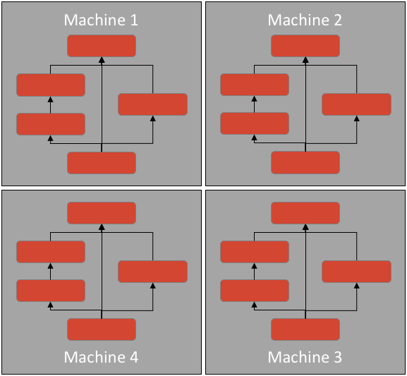
Distributed & Parallel
We need to distribute and train in parallel to be efficient
Data Parallelism
Model Parallelsim
Grid Search
Predict
-> Build in TF
How can we deploy that to a cluster
Schedule TF onto Nodes
Service Discovery
GPUs
-> Kubernetes

Slide 6
Requirements & Content
Basic Knowledge of Neural Networks
Knowledge of Tensorflow
Basic Docker/Kubernetes knowledge
(Docker) Containers: Mini VM (Wrong!)
Kubernetes: Scheduler/Orchestration Tool for Containers
Only focus on the task of parallel and/or distributed training
We will not look at architectures like CNN/LTSM etc

Slide 7
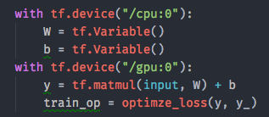


Tensorflow on a single node
Build your Graph
Define which parts on each device
TF places data
DMA for coordination/communication
Define loss, accuracy etc
Create Session for training
Feed data into Session
Retrieve results
Client Code
/job:worker/task:0/
cpu:0
gpu:0

Slide 8
Parameter Server & Worker Replicas
Client Code
Session
Client: Code that builds the Graph, communicates with cluster, builds the session
Cluster: Set of nodes which have jobs (roles)
Jobs
Worker replicas: compute intensive part
Parameter Servers(ps): Holds model state and reacts to updates
Each job can hold 0..* task
Task
The actual server process
Worker Task 0 is by default the chief worker
Responsible for checkpointing, initialising and health checking
CPU 0 represents all CPUs on the Node
Graph
Graph
/job:worker/task:0/
/job:ps/task:0/
cpu:0
gpu:0
cpu:0

Slide 9
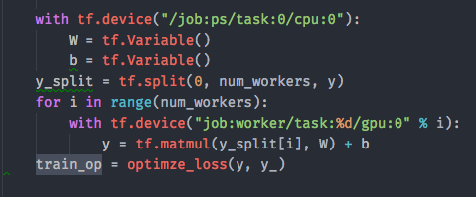
In Graph Replication
Split up input into equal chunks,
Loops over workers and assign a chunk
Collect results and optimise
Not the recommended way
Graph get big, lot of communication overhead
Each device operates on all data
Client Code
/job:worker/task:0/
/job:ps/task:0/
/job:worker/task:0/
cpu:0
gpu:0
cpu:0
cpu:0
gpu:0

Slide 10
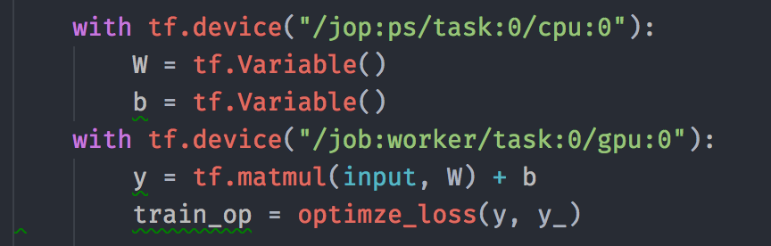
Between Replication
Recommend way of doing replication
Similiar to MPI
Each device operates on a partition
Different Client Program on each worker
Assign itself to local resources
Small graph independently
Client Code
Client Code
/job:worker/task:0/
/job:ps/task:0/
/job:worker/task:0/
cpu:0
gpu:0
cpu:0
gpu:0
cpu:0

Slide 11
Training Modes
How to update the parameters between instances?
Synchronous Replication
Asynchronous Replication
Every Instances reads the same values for current parameters, computes the gradient in parallel and the app them together.
Independent training loop in every Instance, without coordination. Better performance but lower accuracy.

Slide 12
Synchronous Training
Parameter Server
Add
ΔP
ΔP
Update
Model
Model
P
Input
Input

Slide 13
Asynchronous Training
Each updates Independently
Nodes can read stale nodes from PS
Possible: Models dont converge
Parameter Server
Update
Update
ΔP
ΔP
Model
Model
P
Input
Input

Slide 14
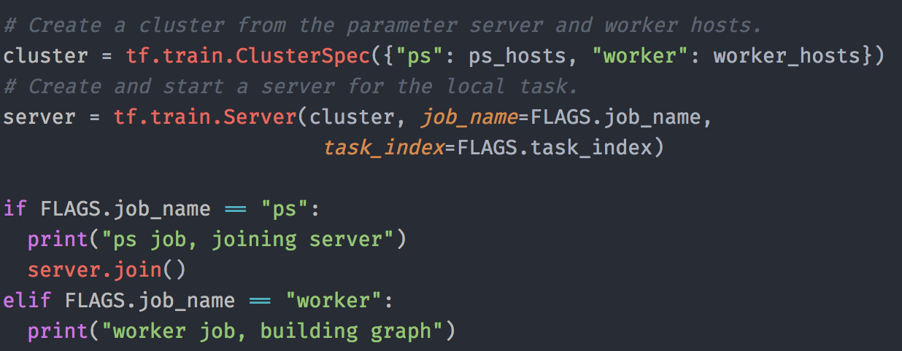
1. Define the Cluster
Define ClusterSpec
List Parameter Servers
List Workers
PS & Worker are called Jobs
Jobs can contain one ore more Tasks
Create Server for every Task

Slide 15
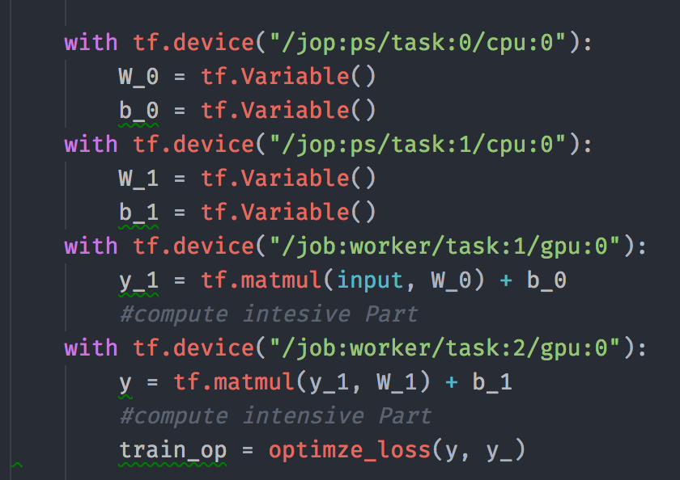
2. Assign Operations to every Task
Same on every Node for In-Graph
Different Devices for Between-Graph
Can also be used to set parts to GPU and parts to CPU

Slide 16
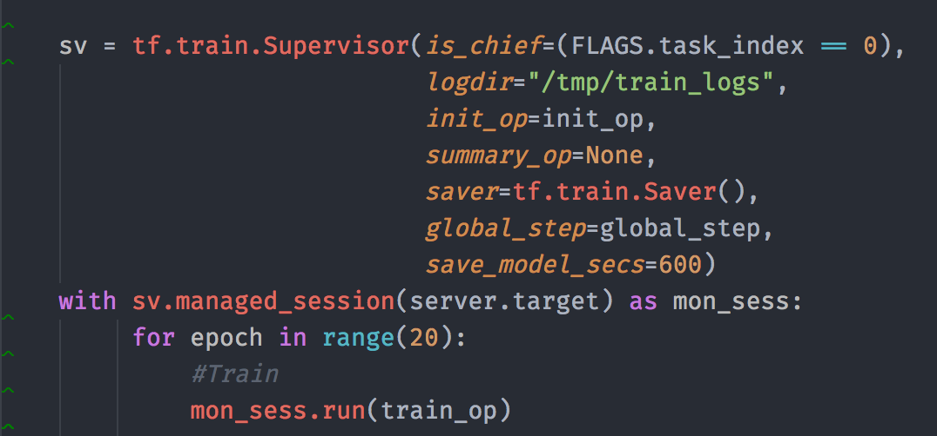
3. Create a Training Session
tf.train.MonitoredTrainingSession or tf.train.Supervisor for Asyncronous Training
Takes care of initialisation
Snapshotting
Closing if an error occurs
Hooks
Summary Ops, Init Ops
tf.train.SyncReplicaOptimizer for synchronous training:
Also create a supervisor that takes over the role a a master between workers.

Slide 17
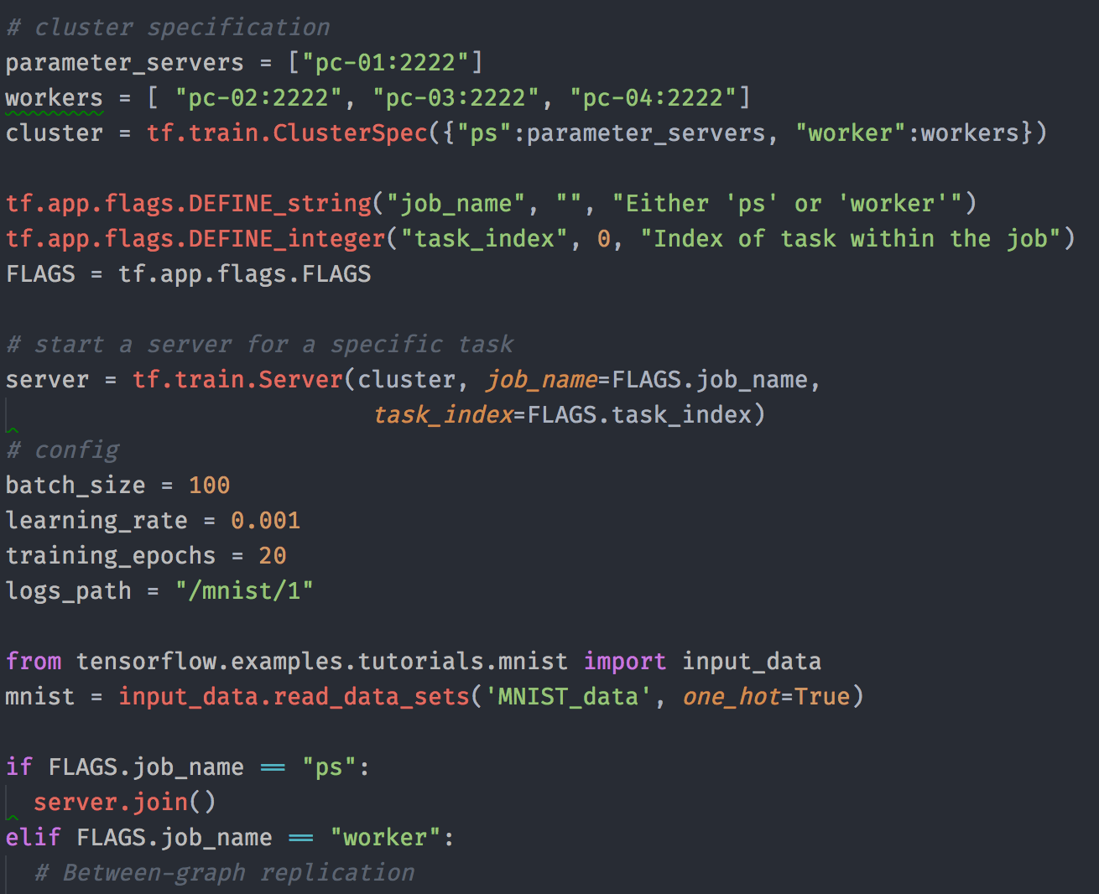
All Together - Server Init

Slide 18
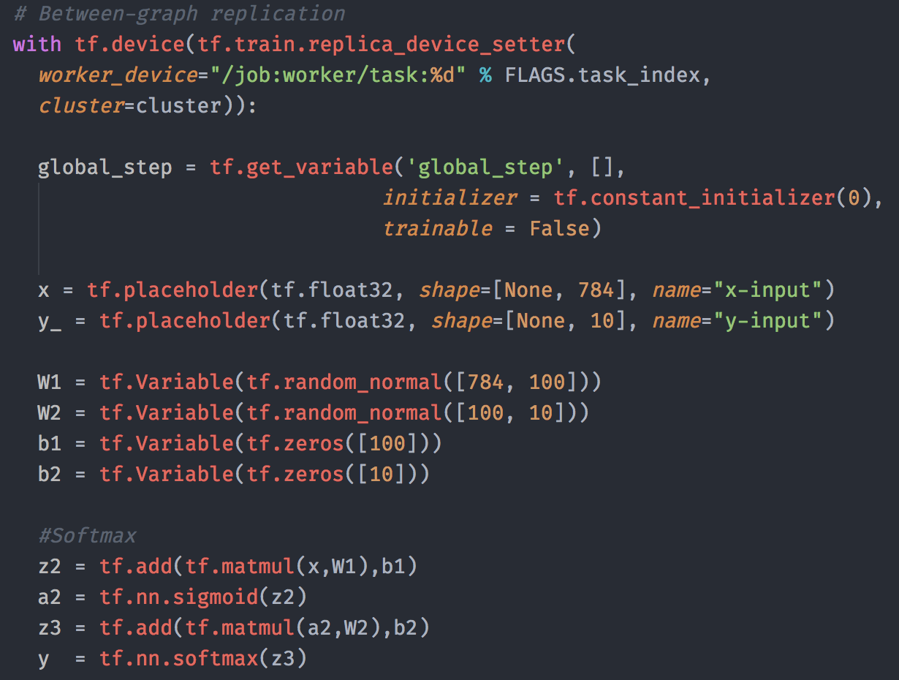
All Together - Building Graph

Slide 19
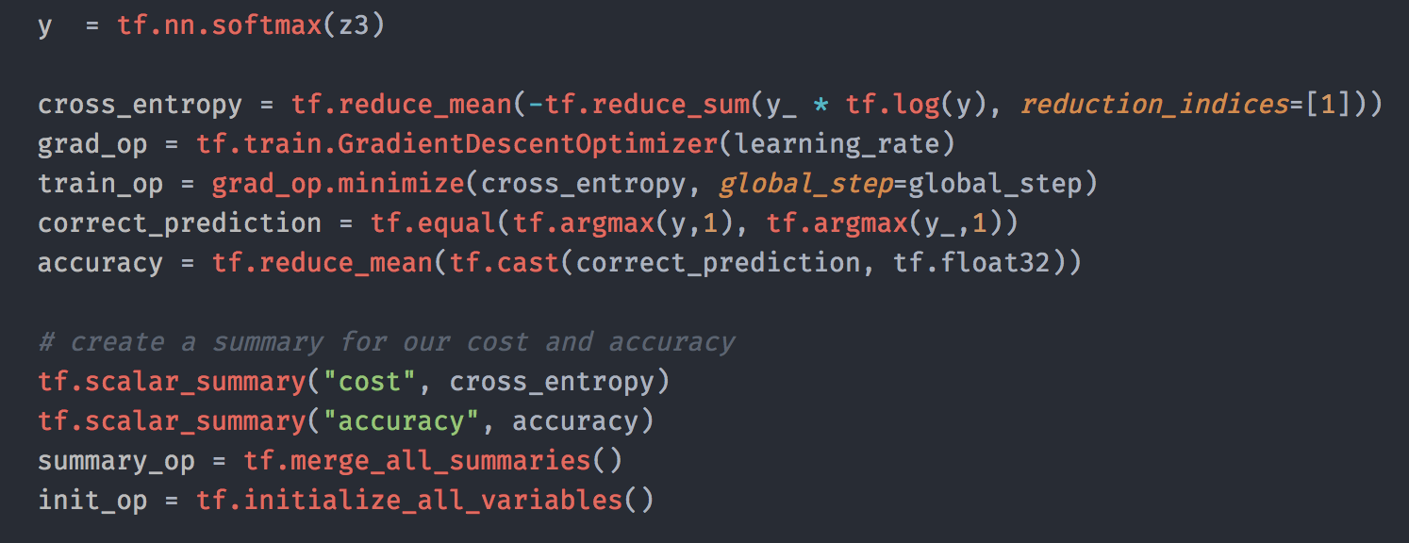
All Together - TrainingOP

Slide 20
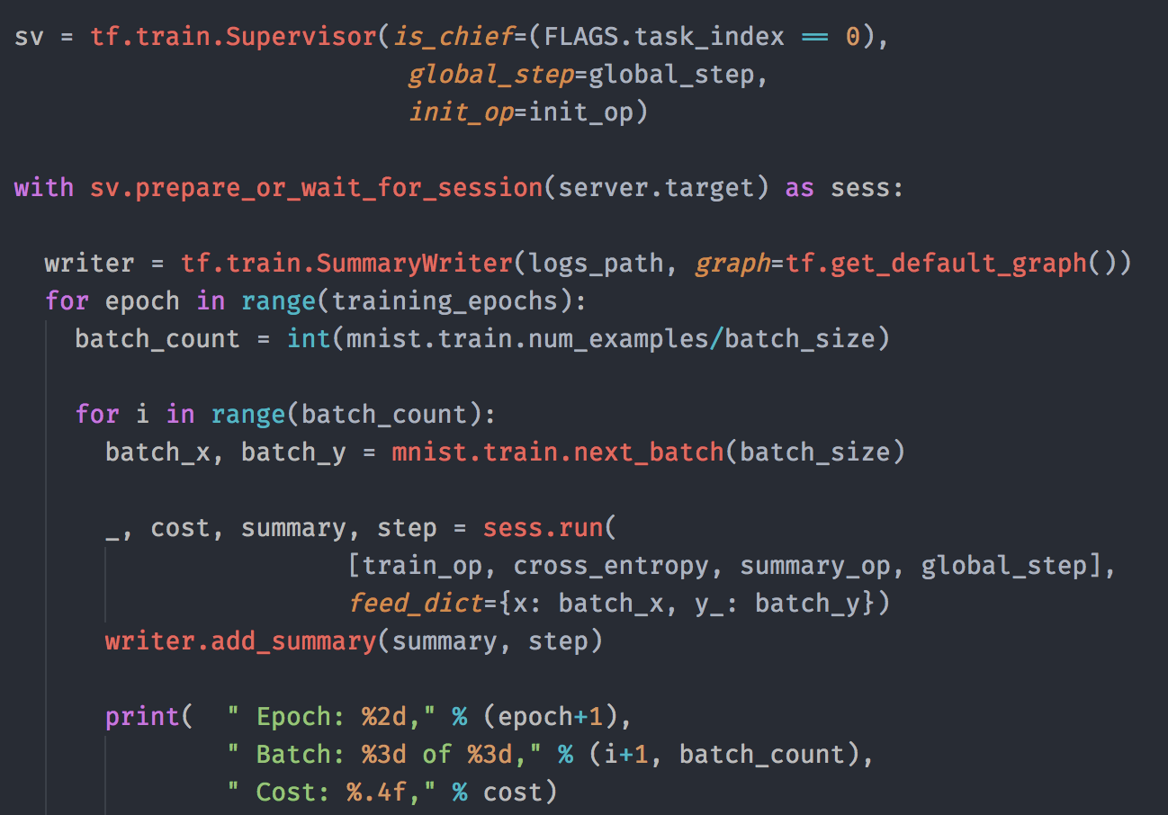
All Together - Session & Training

Slide 21
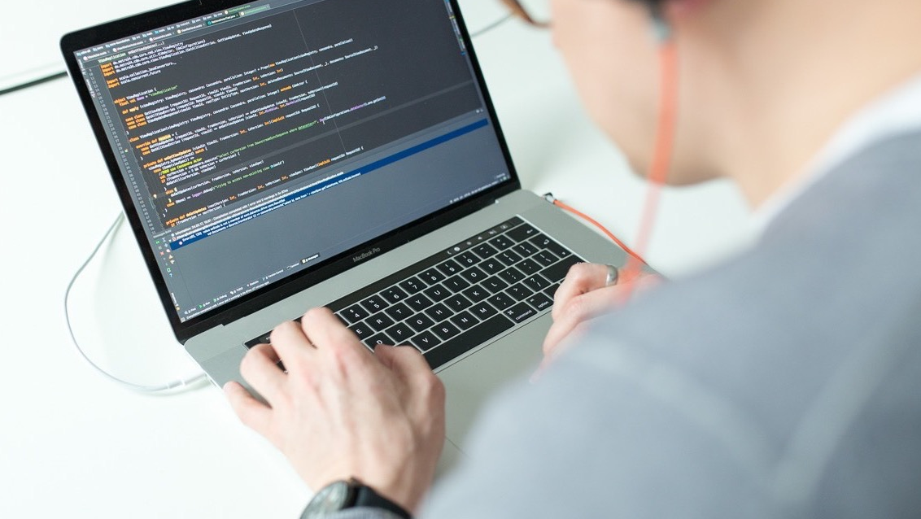
Tensorflow on Kubernetes

Slide 22
Packaging
The Application (and all its) dependencies needs to be packaged into a deployable artefact
Wheels
Code into deployable artefact with defined dependencies
Dependent on runtime
Container
Build Image with runtime, dependencies and code
Additional Tooling for building and running required (Docker)

Slide 23

Kubernetes
Kubernetes is a the leading Container Orchestration.
GPU Support
Developer friendly API
Alpha since 1.6
(experimental before)
Quick deployments through simple and flexible API.
Huge Community
Open Source
One of the fastest growing community
Open Sourced by Google, now member of Cloud Computing Foundation.
Auto Scaling
Bin Packing
Build in Auto Scaling Feature based on Ultitisation
Efficient resource utilisation

Slide 24
Kubernetes in 30 Seconds
The Basic you need to know for the Rest of the Talk
Pods
API First
Deployments
Service Discovery
Pods can be 1 or more Container grouped together, smallest scheduling Unit..
Everything is a Object inside the Rest API. Declarative Configuration with YAML files.
Higher Level Abstraction to say run Pod X Times.
Services are used to make Pods discovery each other.

Slide 25
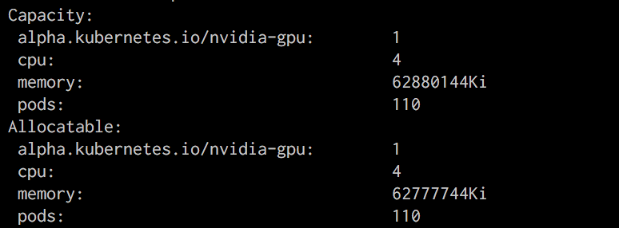
How to enable GPU in your K8S cluster?
—KUBELET FLAG
—feature-gates= "Accelerators=true"
Install Docker, nvidia-docker-bridge, cuda
Out of Scope for a Data Conference

Slide 26
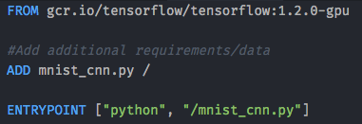
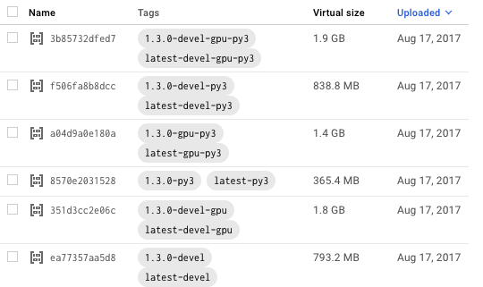
Single Worker Instance
Prepare our Docker Image
Use prebuild Tensorflow image and add additional libraries & custom code (gcr.io/tensorflow/tensorflow)
Special images for cpu/gpu builds, see docker hub tags
Build & Push to a registry

Slide 27
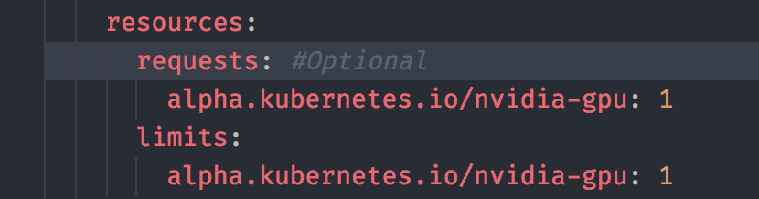
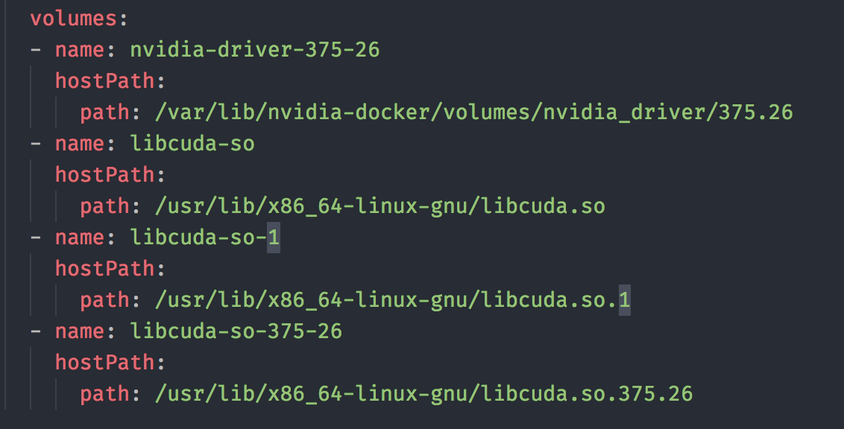
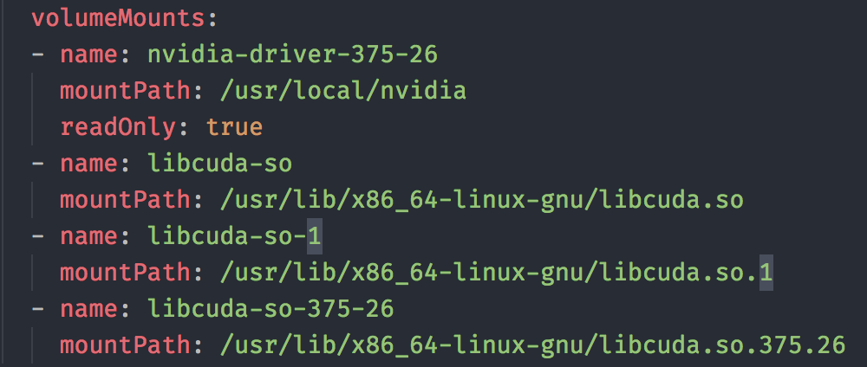
Write Kubernetes Pod Deployment
Tell kubernetes to use GPU resource
Mount NVIDIA libraries from host

Slide 28
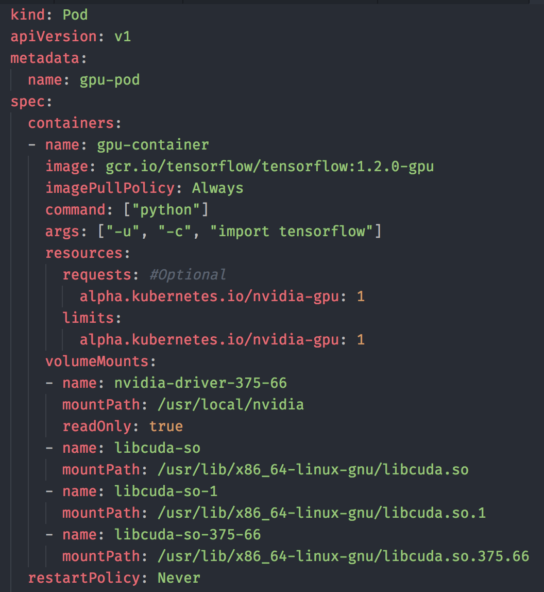
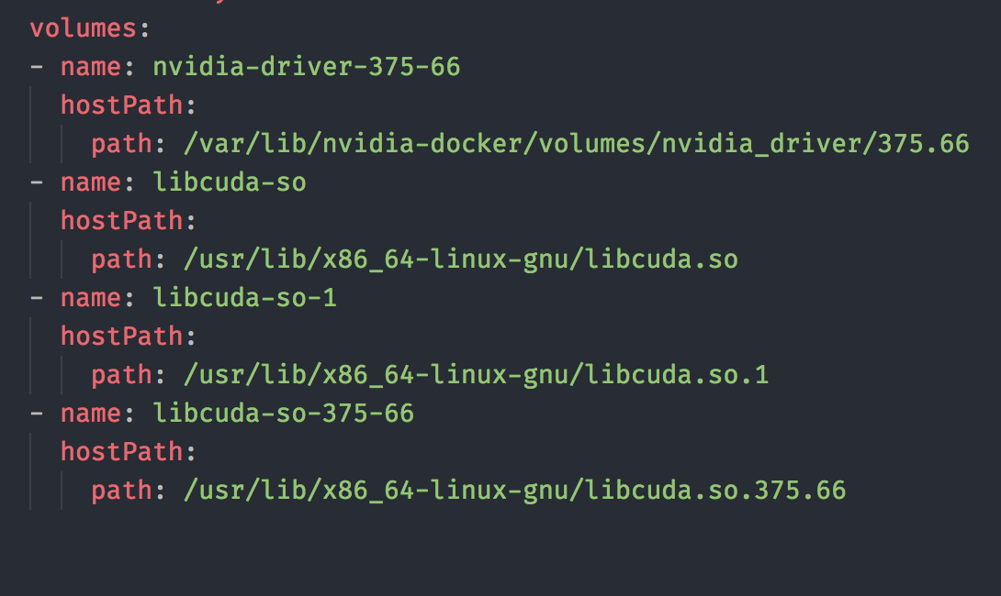
Full Pod Yaml

Slide 29
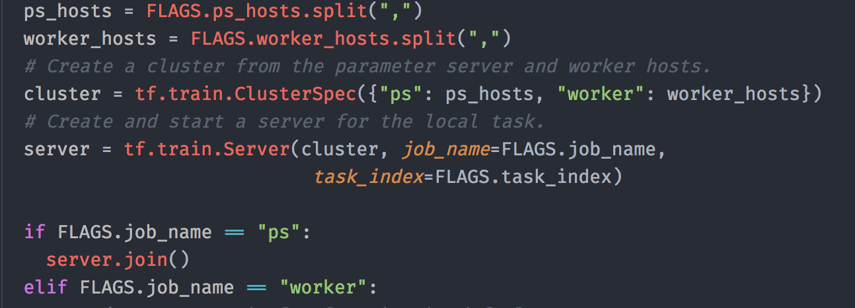
Distributed Tensorflow - Python Code
Add clusterSpec and server information to code
Use Flags/Envirmoent Variable to inject dynamically this information
Write your TF Graph
Either Manual Placement or automatic
Dockerfile stays same/similiar

Slide 30
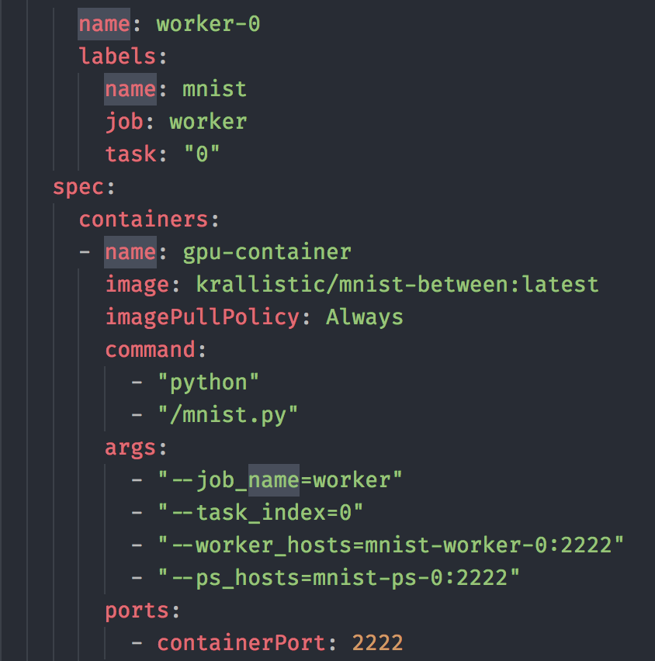
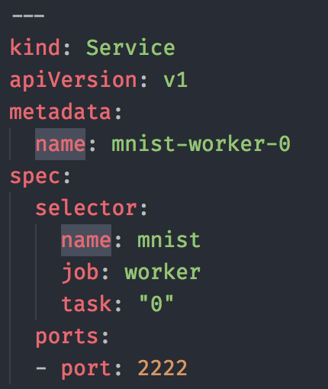
Distributed Tensorflow - Kubernetes Deployment
Slightly different deployments for worker and ps nodes
Service for each woker/ps task
Job Name/worker index by flags

Slide 31
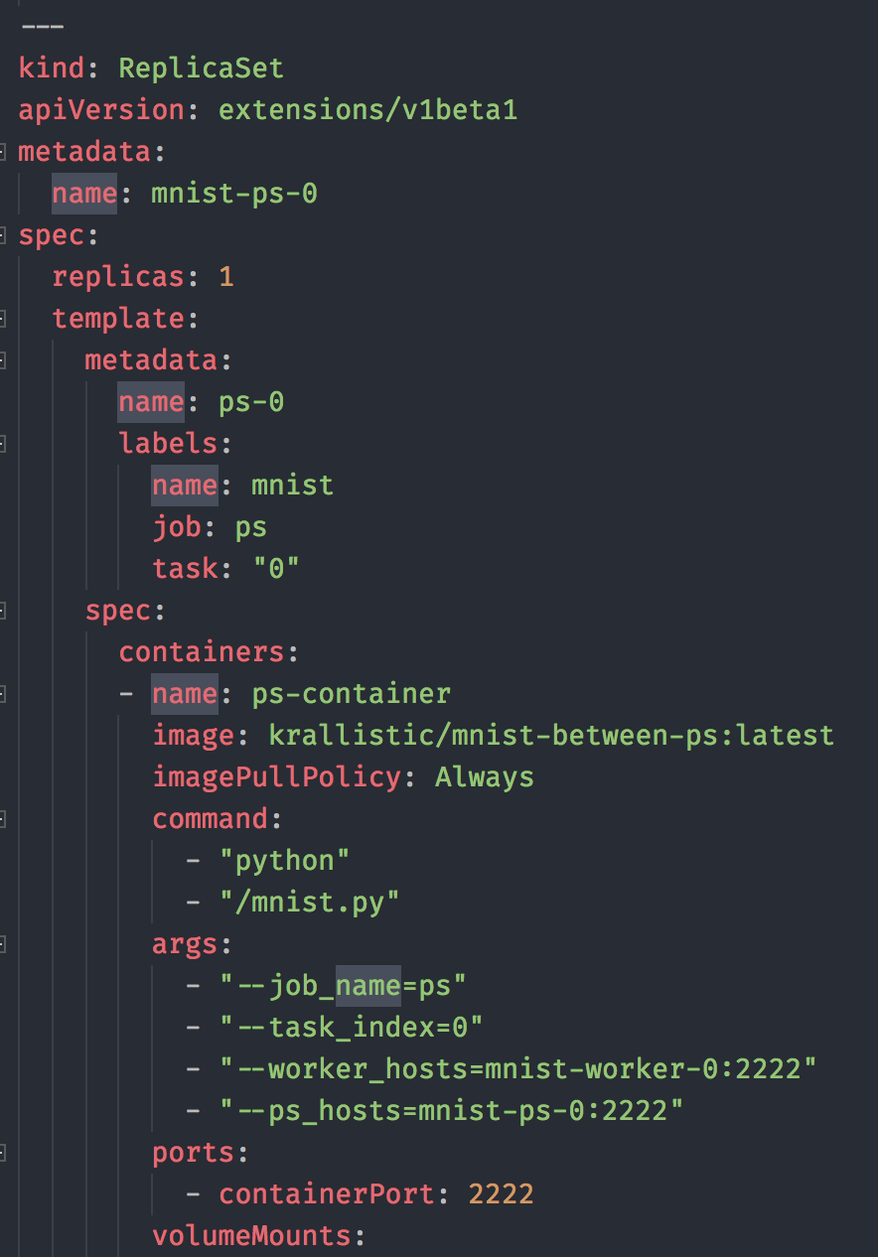
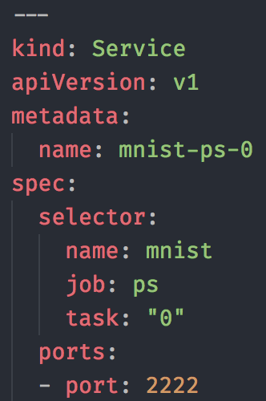
Distributed Kubernetes - Parameter Server

Slide 32
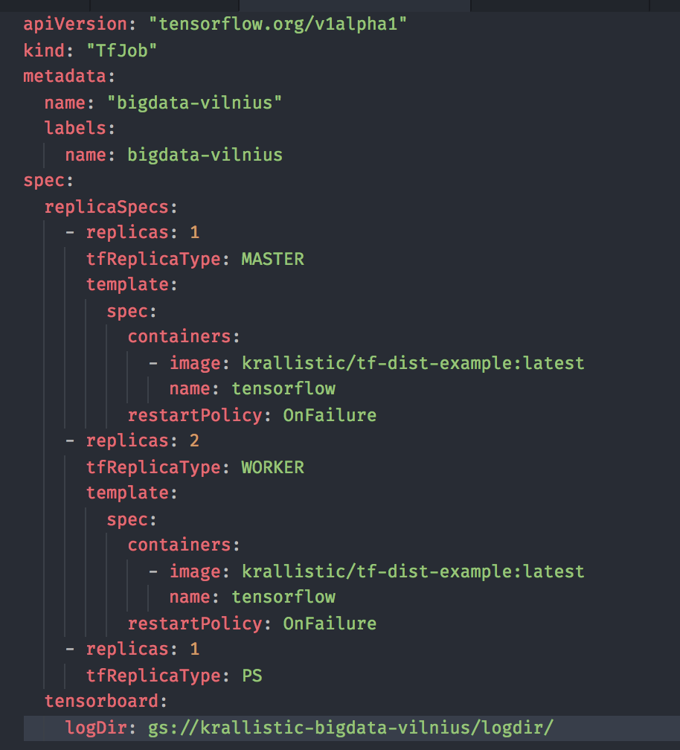
Automation - Tensorflow Operator
Boilerplate code for larger cluster
Official Documentation: Jinja Templating
Tensorflow Operator:
Higher level description, creates lower level objects.
Still in the Kubernetes API (though CustomResourceDefinition)
kubectl get tfjobs
Comping Soon: https://github.com/krallistic/tensorflow-operator
Now: https://github.com/tensorflow/k8s

Slide 33
Don’t do this at home work
*Unless you really need to

Slide 34
Questions? Demo?

Slide 35
Variable Placement
How to place the Variable onto different devices
Manual Way
Easy to start, full flexibility
Gets annoying soon
Device setter
Automatic assign variables to ps and ops to workers
Simple round robin by default
Greedy Load Balancing Strategy
Partitioned Values
Needed for really large variables (often used in text embeddings)
Splits variables between multiple Parameter Server

Slide 36
Additional Stuff
Tensorboard:
Needs a global shared filesystem
Instances write into subfolder
Tensorboard Instances reads full folder
Performance
Scales amount of Parameter Servers
Many CPU nodes can be more cost efficient

Slide 37
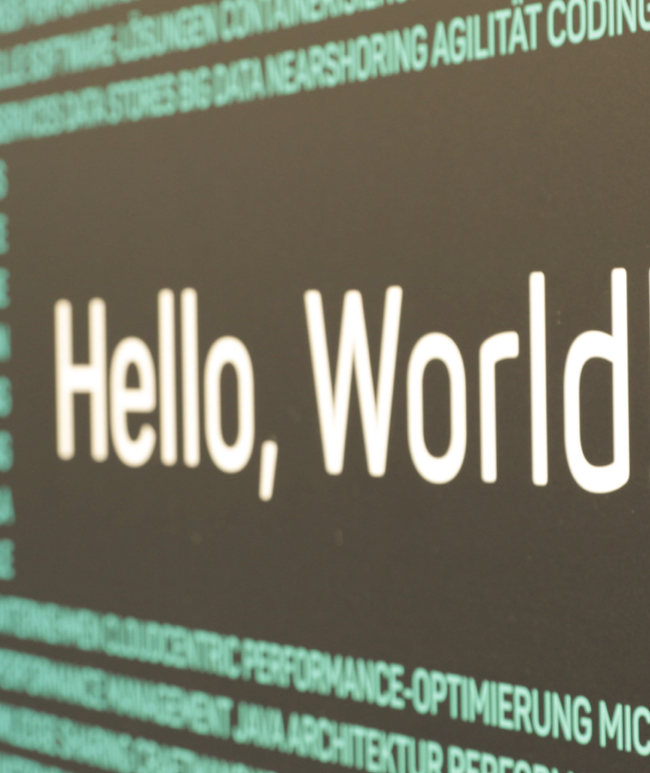
Questions?
Address
codecentric AG
Gartenstraße 69a
76135 Karlsruhe
Contact Info
E-Mail: jakob.karalus@codecentric.de
Twitter: @krallistic
Github: krallistic
www.codecentric.de

